Slide 1

Components of Great Communication

Slide 2

What We Will Cover
Communication Defined
The Different Forms
Why They All Matter
Tips and Guidelines for Great Communication
Self-Assessment
Action Plans

Slide 3
Communication is All-Inclusive
Communication is any and all means of sending or receiving information
It is used to convey multiple thoughts, including specific ideas as well as emotions
Can be fact or opinion
A variety of media, forums and delivery methods may be used
Purposes vary but are usually intended to inform or convince

Slide 4
The Different Forms
Verbal (group and 1-on-1)
Non-Verbal
Feedback Sessions
Written (email, text, report)
Presentations
Social Media

Slide 5
Why They All Matter
You are always being evaluated in some manner
First impressions often last and can be difficult to overcome
Always put your best foot forward
Perception can have a major impact on professional success

Slide 6
First Impressions
Be confident
Present a positive, professional Image
Be clear and credible
Know your material
Arrive early

Slide 7

Verbal and Non-Verbal Communication
Think before you speak
Be concise and have a point that you want to make
Adopt the 30-second rule
Be self-aware
Be authentic: don’t try to be someone you’re not
Solicit feedback
Ask: “does that make sense?” to ensure understanding

Slide 8
Effective Conversations
Use stories with “heroes”
Don’t be afraid to be passionate
Go for impact
Influence and inspire your audience
Keep the audience engaged

Slide 9
Feedback
Be comfortable giving and asking for feedback
Authentic feedback makes us better
Make sure it’s timely
Do regular check-in’s
Use concrete examples
Use the ‘Sandwich Technique’ to make requests

Slide 10
Written Communication
Do not solely rely on spell check: proof-read it yourself!
Know your audience
Make it easy for them to grasp
Make it simple to read: bullets and white space vs. block text
Use highlighting to emphasize key points
Focus on what your recipients need to know
Remove the emotion before hitting “send”

Slide 11
Components of a Good Presentation
Has a short intro
Has a clear, concise goal
Has an impact statement
Has a persuasive point
Is user friendly
Stays away from acronyms/slang/controversy

Slide 12
Social Media
Have a personal brand
Be very conscious of what you post
Know the boundaries of what is appropriate
Use platforms the proper way

Slide 13
Additional Tips and Guidelines
Keep it interesting
Be attuned to your audience
Use humor appropriately and sparingly
Stay focused on your goal
Ask “good” questions
Engage in active listening

Slide 14
What are “Good” Questions?
Demonstrate that you were listening
Use open-ended questions
Establish mutual understanding
Enhance the knowledge of both parties

Slide 15
Active Listening
The key is seeking to understand; we all have different filters
People hear what they want to hear
Terms and concepts can be interpreted multiple ways
Ask for clarification and share any questions you have
Both parties must have the same understanding for communication to be effective

Slide 16
Keys to Success
Have a clear objective for all formal communication
Always be aware of how you come across
Think like your audience
Be an efficient communicator
Confirm understanding
Make sure your stated goal was achieved

Slide 17
Self-Assessment
Know your communication skills
Be honest!
Nobody is perfect
Incorporate feedback to improve your weaknesses and leverage your strengths

Slide 18
“You can have brilliant ideas but if you can't get them across, your ideas won’t get you anywhere.”
- Lee Iacocca

Slide 19

Action Plans
What will you do differently to improve your communications, over the next 30 days?
Be specific about the changes you will make
Follow up with yourself
Solicit feedback from others
Commit to continuous improvement

Slide 20
Your Kepro EAPur Kepro EAP
EAP Services available to employees, any household members and dependents
Confidential
EAP Counselors available 24/7/365 via 833-539-7285
Up to 6 in person counseling sessions, per issue, per year, per household member
Management Consultations
Financial/Legal Consultation and Referral Service
Work/Life & Convenience Services
https://sowi.mylifeexpert.com Company code: SOWI

Slide 21
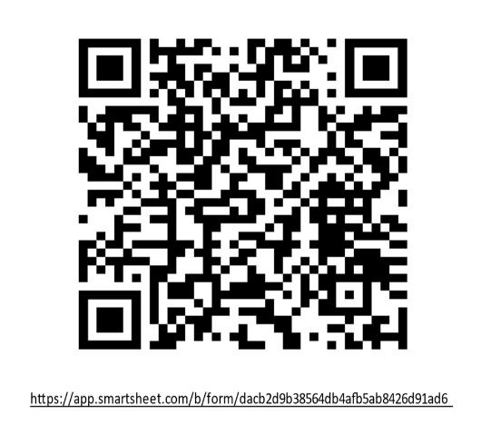
Please complete a training evaluation.
Thank you!

Slide 22

Questions & Answer
Components of Great Communication

